Slide 1
Capstone Project
Airbnb Booking Analysis
Mihir Bhatia

Slide 2

Points for Discussion
Introduction
Problem Statement
About Dataset
Feature Engineering
Exploratory Data Analysis
Conclusion

Slide 3
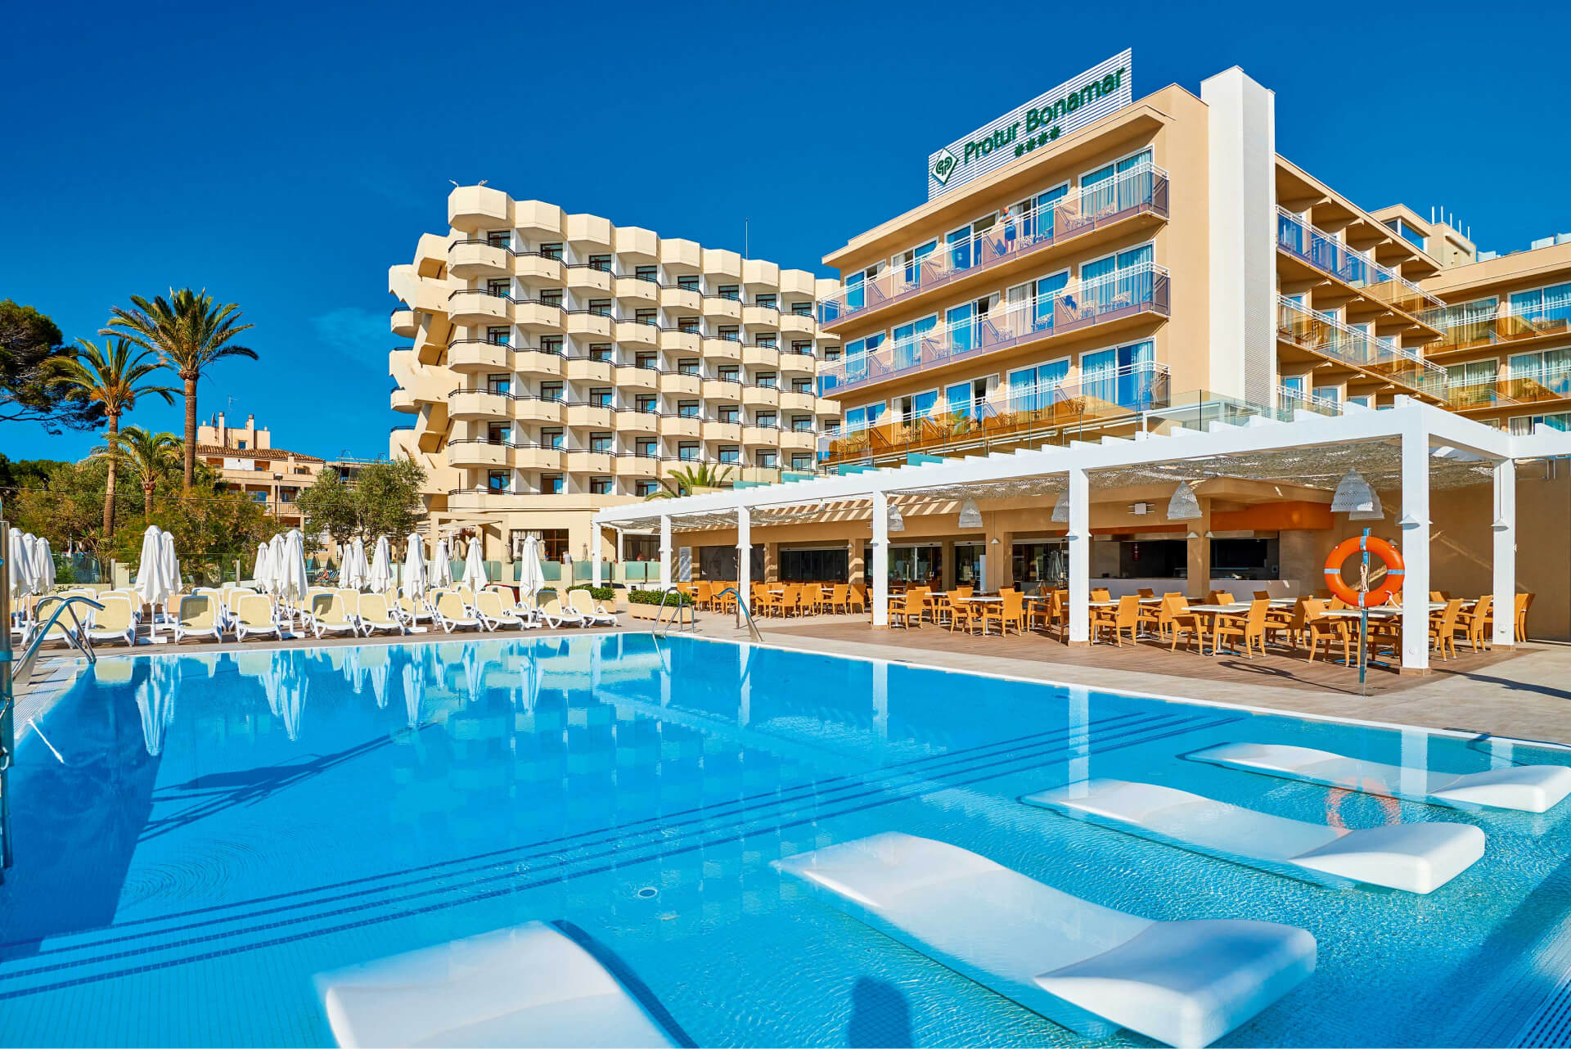
Need for Hotels
● HOTELS AND HOTEL INDUSTRY. The primary purpose of hotels is to provide travelers with shelter, food, refreshment, and similar services and Foods, offering on a commercial basis things that are customarily furnished within households but unavailable to people on a journey away from home.
● Historically hotels have also taken on many other functions, serving as business exchanges, centers of sociability, places of public assembly and deliberation, decorative showcases, political headquarters, vacation spots, and permanent residences.
● The hotel as an institution, and hotels as an industry, transformed travel all over the world, hastened the settlement of the continent, and extended the influence of urban culture.

Slide 4
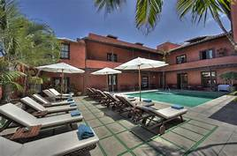
Introduction
Hotel and lodĀinĀ businesses are mainstays oÿ their communities, and an important source oÿ quality jobs. Seventy percent oÿ mayors surveyed said hotel jobs provide the most opportunity, Āood benefits and waĀes within the tourism industry. They also noted that hotels support their communities throuĀh increased tax revenue, capital investment, tourism-related development and promotion, civic leadership, and charitable contributions and sponsorship.
● It can be really appreciated iÿ we have data collected in the bookinĀ behavior across many places, because then we will be able to drive Āreat insiĀhts which will ÿurther help in tarĀetinĀ our audience and many more aspects.

Slide 5
About the Data
hotel : CateĀorical column with inÿormation about the type oÿ hotel (City/Resort).
● is_canceled : Boolean Type with inÿormation about cancellation oÿ bookinĀ.
● lead_time : The time they are scheduled to arrive at the hotel.
● arrival_date_year : Which has the Āuest arrived.
● arrival_date_month : Which month oÿ the year the Āuest checked in.
● arrival_date_week_number : Which week oÿ the month the Āuest checked in.
● arrival_date_day_oÿ_month : which date oÿ the month the Āuest checked in.
● stays_in_weekend_niĀhts : Number oÿ Āuest stayed durinĀ the weekend niĀhts.
● stays_in_week_niĀhts : Number oÿ Āuest stayed durinĀ the week niĀhts
● adults : counts oÿ adults
● children : count oÿ children.
● babies : count oÿ babies.
● country : Codes names oÿ the countries where the hotels are.
● market_seĀment : dividinĀ potential Āuests into Āroups based on a set oÿ shared characteristics.
● distribution_channel : Different channels oÿ a hotel to receive bookinĀs.
● is_repeated_Āuest : Boolean type, weather the Āuest has come beÿore or not.
● researved_room_type : room types reserved durinĀ bookinĀ.
● assiĀned_room_type : room assiĀned to the Āuest.
● customer_type : cateĀorical type column holdinĀ inÿormation about the type oÿ Āroup. ● adr : averaĀe daily rate.
● reservation_status_date : inÿormation reĀardinĀ date oÿ check in/check out

Slide 6
Preprocessing few coloumns
Combining reserved_room_type and assigned_room_type to a single column to check weather the room that booked was assigned or not.
● Reserved room == Assigned room ---> 1
● Reserved room != Assigned room ---> 0

Slide 7
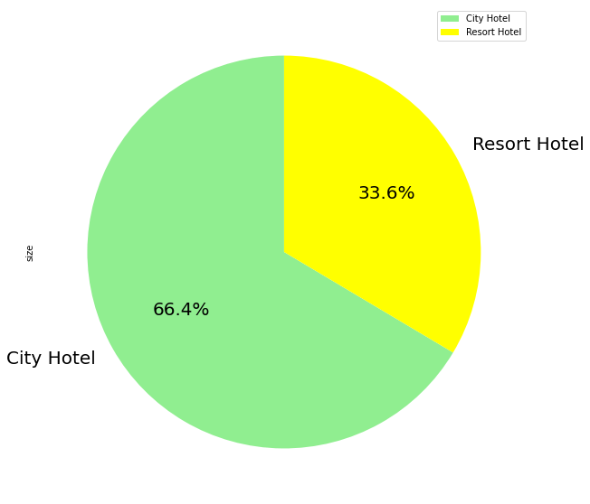
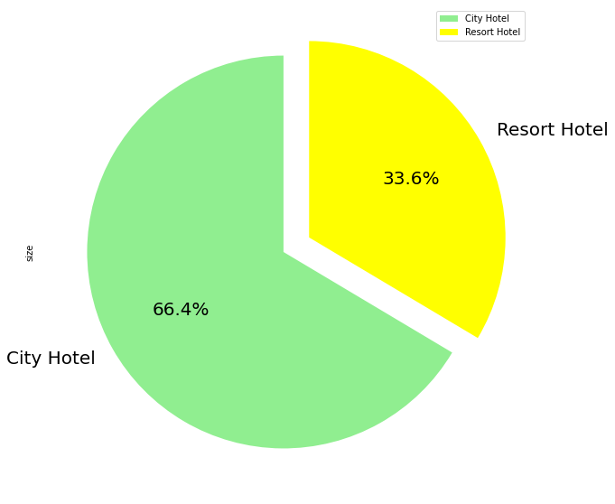
As clear from the pie-charts 66% booking are from City Hotels and 34% is from Resort Hotel
EDA

Slide 8
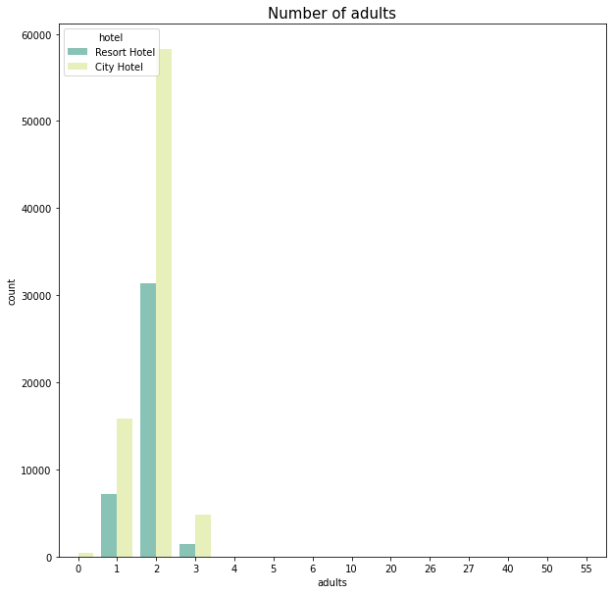
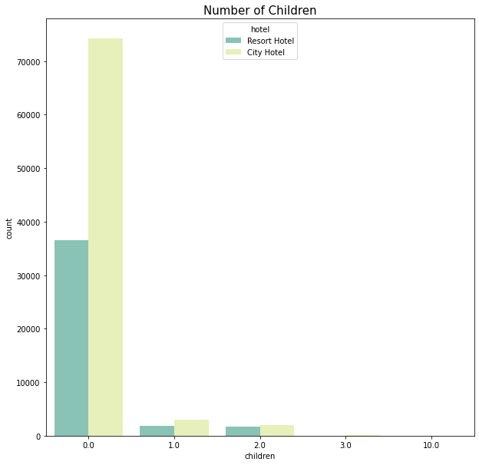
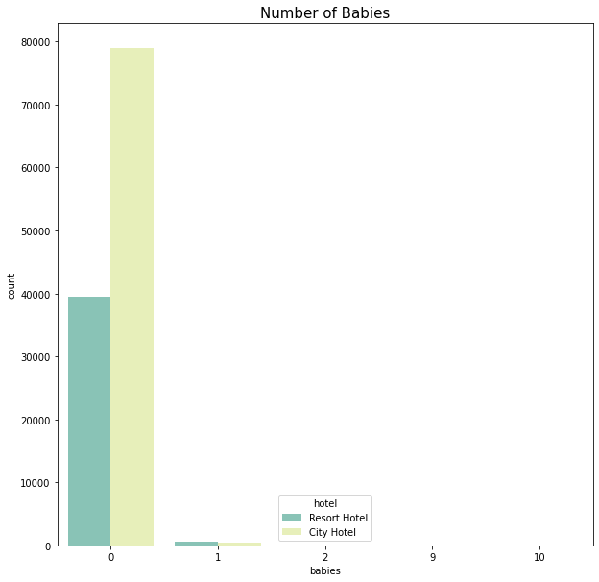
Analysing Different population of visitor in hotels
One thinĀ is clear that our tarĀet audience and most majority population are adults.
And by pair we have Āive out a hypothesis oÿ couples and younĀsters
people with children and baby have no specific choices oÿ the type oÿ hotels.

Slide 9
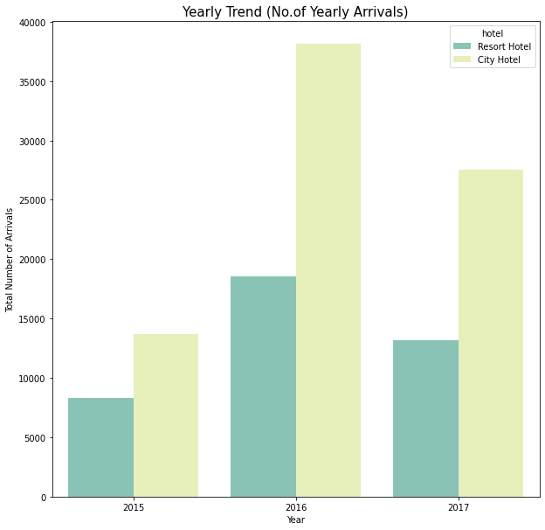
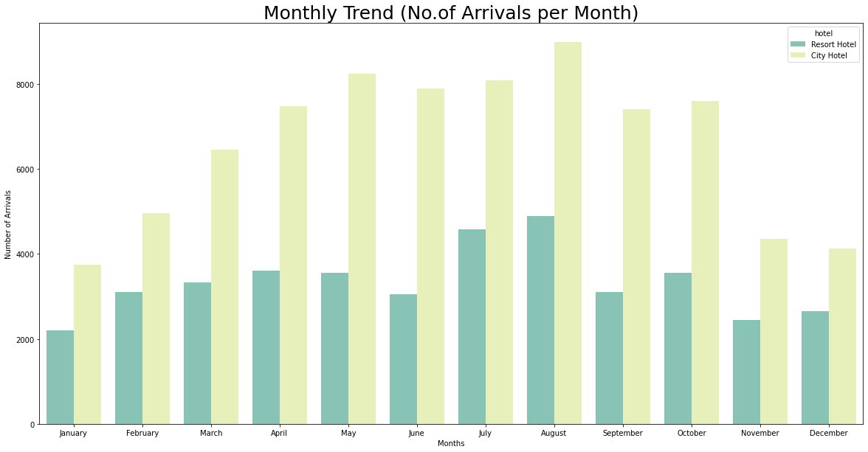
● 2016 was the year where the most hotel bookinĀ would have take taken place. ● Most bookinĀ spikes durinĀ the summer season.
Arrival Trends

Slide 10
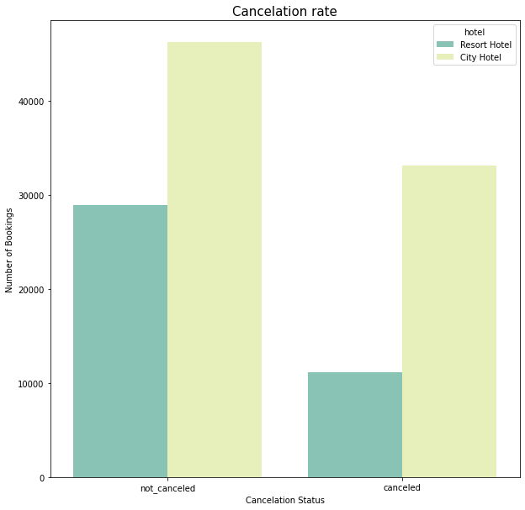
Cancellation Rate
Since 66 percent of the hotels were city hotel thus as expected the the cancelation in the city hotels were higher but if we take the rate of cancellation into consideration we see that there is not much noticeable difference between the both of them compared to the numbers and weightage.

Slide 11
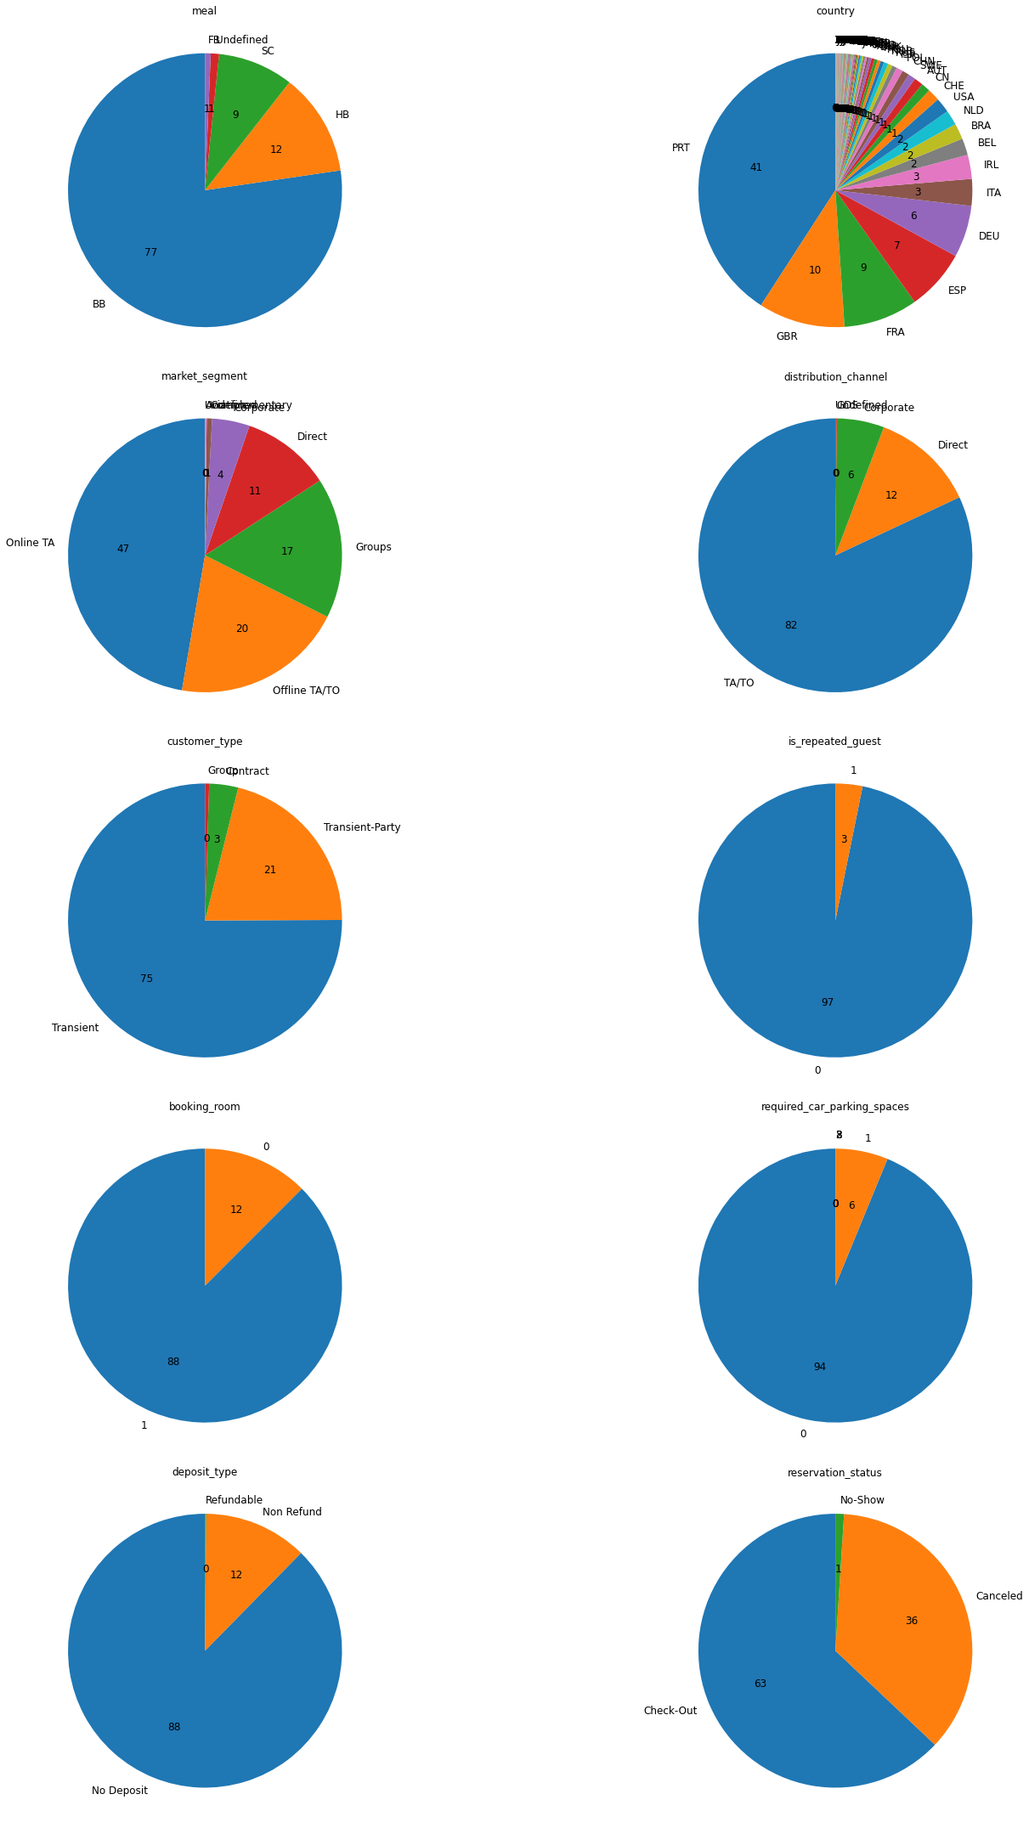
Important Insights from the above visualization 1) Our country pie Chart is little messy but we can easily figure out the top countries are from UK, where 41 percent bookings are from PRT (Portugal), 10 percent from GBR (Great Britain), 9 percent from FRA (France) and 7 percent from ESP (Spain). 2) Major market_segments are Online TA and Offline TA/TO (Online/Offline Target audience) 3) Offline TO holds a whooping 82 percent weightage in distribution 4) 75%, 21% are Transient stays and Transient parties respectively (Transient ~ short duration stays). Thus; marketing special less day offer packages for stay and resort for parties for discounted prices will increase the bookings.
Eda (continued)

Slide 12
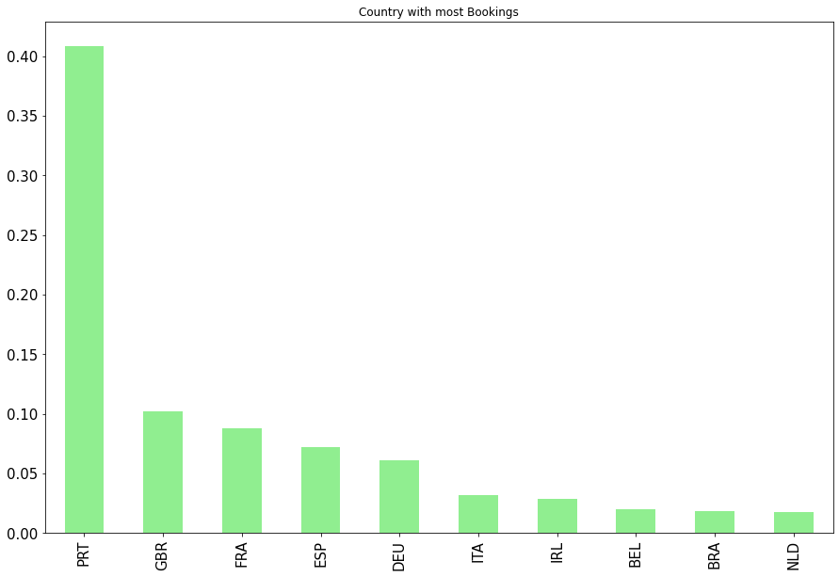
5) The repeated guests are only 3 percent. Hence; this need to be improved - can be through email marketing of discounts or making some kind of membership cards to avail offer if they visit again in certain time period. 6) 88% of the people were assigned the same room of what they have booked rest were assigned something they didn't ask for, this can have negative impact and hence need to be reduced. 7) We see that there are 88 percent hotels which take no deposit fees and thus this may be the reason why there are so many cancellations.

Slide 13
1. City hotels are in the highest demands and are often booked more due to less 'adr' and many other factors 2. The most bookings is from the country "Portugal". Hence we need to focus more on this country. 3. Families with children have no specific choice among the type of hotel 4. People only book for shorter time, hence package modification and discounts for shorter time should be introduced. 5. There is almost no repeated guest, which can be solved by specific membership discounts and other approaches.
Conclusion

Slide 14


